Slide 1
Recent Developments in Algebraic Proof Complexity Iddo Tzameret Tsinghua Univ. Based on Pavel Hrubeš and T. [CCC ‘09, STOC ’12]

Slide 2
Recap: The propositional world:
Frege systems

Slide 3
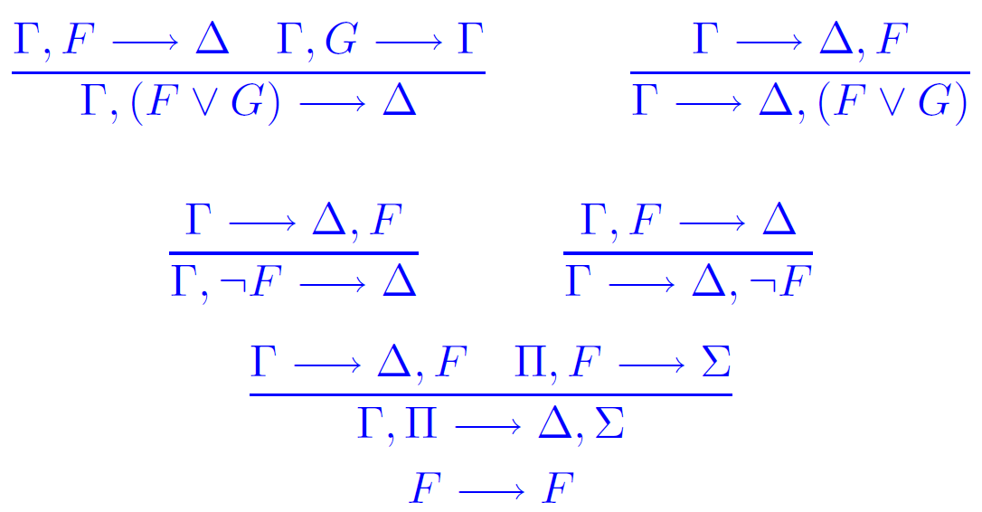
Frege proofs
Take any standard textbook proof systems: Frege, sequent calculus, Hilbert style, Natural deduction… Reckhow: it doesn’t matter!
Two rules for each connective, one for each side:
Cut:
Axiom:

Slide 4
Complexity of Proofs
Fundamental open problem in logic & complexity:
Prove super-polynomial lower bounds on propositional proofs!
Notes:
6’
Motivations: understand the circuit based Frege hierarchy; separations, possible separations, understand better analogy with circuit complexity, if any.
--Note: the rules have to be slightly accommodated when speaking about circuits and not formulas: the similarity rule
- Don’t require poly-size for NC2-Frege proofs

Slide 5
Circuit based proofs

Slide 6
Circuit based proofs
Think of every proof-line as a circuit:
NC¹ circuits: poly(n) size, O(log n) depth (poly-size formulas; n=# of vars)
NC¹-Frege (=Frege): proof-lines are formulas
NC² circuits: poly(n) size, O(log²n) depth
NC²-Frege: O(log²n) depth proof-lines
P/poly circuits: poly(n) size
P/poly-Frege (=eFrege): proof-lines are circuits
Notes:
6’non formal notation
Motivations: understand the circuit based Frege hierarchy; separations, possible separations, understand better analogy with circuit complexity, if any.
--Note: the rules have to be slightly accommodated when speaking about circuits and not formulas: the similarity rule
- Don’t require poly-size for NC2-Frege proofs

Slide 7
Circuit based proofs
Again:
Polynomial-size NC²-Frege proofs:
n = number of variables
Size of proofs = poly(n)
Depth of proof-lines = O(log²n)
Note 1: Quasipolynomial-Frege ≥ NC²-Frege
Note 2: Dealing with circuits: add “circuit axiom” (Jeřabek)
Notes:
6’non formal notation
Motivations: understand the circuit based Frege hierarchy; separations, possible separations, understand better analogy with circuit complexity, if any.
--Note: the rules have to be slightly accommodated when speaking about circuits and not formulas: the similarity rule
- Don’t require poly-size for NC2-Frege proofs

Slide 8
Case study: linear algebra
Conjecture:
Determinant not in NC¹
Properties of determinant outside poly-size NC¹-Frege proofs.
Known: Determinant in NC²
Question: Can we prove properties of determinant with poly-size NC²-Frege proofs ?
Conjecture: “Yes!” (Cook; Rackoff; Bonet, Buss & Pitassi; Soltys); specifically:
INV_{n}: AB=I→BA=I has NC²-Frege proofs
Notes:
11’
Which determinant in NC2 over gf(2)?
Philosophy of analogy between circuits and proofs

Slide 9
Case study: linear algebra
Previous work: Soltys and Cook (‘04): poly-size Extended Frege proofs for hard-matrix identities like INV_{n}
Thm (Hrubeš and T. 2012): Polynomial-size
NC²-Frege proofs of:
Det(A)∙Det(B)=Det(A∙B)
over GF(2), where Det(∙) is the determinant function.
Notes:
11’
Which determinant in NC2 over gf(2)?
Philosophy of analogy between circuits and proofs

Slide 10
Case study: linear algebra
Previous work: Soltys and Cook (‘04): poly-size Extended Frege proofs for hard-matrix identities like INV_{n}
A,B nxn 0-1 matrices
Each proof-line: O(log²n) depth
Proof size: n^{O(1)}
How to express matrix identities as propositional circuits? Matrix A identified with n² circuits a^{ij}
Matrix identities A=B are written as n² identities a_{ij}=b_{ij}
Thm (Hrubeš and T. 2012): Polynomial-size
NC²-Frege proofs of:
Det(A)∙Det(B)=Det(A∙B)
over GF(2), where Det(∙) is the determinant function.
Notes:
11’
Which determinant in NC2 over gf(2)?
Philosophy of analogy between circuits and proofs

Slide 11
Consequences
From this we can already efficiently prove other statements like:
AB=I→BA=I
(AB)⁻¹=B⁻¹A⁻¹
Cofactor expansion
Cayley-Hamilton Theorem
etc.
Notes:
13’
Most constructive proof of linear algebra (conjectured to be optimal);
Gives a better understanding of the Frege Hierarchy;
Strengthens the connection between provability and computation;
Feasible mathematic.
These statements can be encoded in the obvious way as n^2 equations
Hard= super-polynomial size lower bounds
Conj 2 also yields a quasipolynomial Frege proof

Slide 12
Arithmetic proofs
(Hrubes & T. 2012): There is a circuit Det and poly-size Arithmetic proofs of (over any field):
Det(A)∙Det(B)=Det(A∙B)
Det(C)=c₁₁∙c₂₂∙∙∙c_{nn}
for any A,B,C nxn matrices and C triangular
Note: Det(∙) must be the determinant function.
These are poly(n) size proofs operating with equalities between algebraic circuits of O(log²n)-depth
Notes:
13’
Most constructive proof of linear algebra (conjectured to be optimal);
Gives a better understanding of the Frege Hierarchy;
Strengthens the connection between provability and computation;
Feasible mathematic.
These statements can be encoded in the obvious way as n^2 equations
Hard= super-polynomial size lower bounds
Conj 2 also yields a quasipolynomial Frege proof

Slide 13
The
Algebraic World

Slide 14
Algebraic circuits
Fix a field F
An algebraic circuit over F
computes a formal
polynomial over F
(x₁+x₂)∙(x₂+3)= x₁x₂+x₂²+3x₁+3x₂
Size = number of nodes
^{output}
˟
+
+
x₁
x₂
3
Notes:
14’ Differs from computing Boolean functions
These statements can be encoded in the obvious way as n^2 equations
Hard= super-polynomial size lower bounds
Conj 2 also yields a quasipolynomial Frege proof

Slide 15
Proof systems in the algebraic world?
Proofs of polynomial identities:
F=G
For F,G algebraic circuits
E.g.: (x₁+x₂)∙(x₂+3) = x₁x₂+x₂x₂+3x₁+3x₂
BPP language (unlike TAUT in coNP)
Note: not (algebraic) propositional proofs!
Notes:
Propositional algebraic proofs already established.

Slide 16
Arithmetic proofs
Proof-lines: equations between algebraic circuits
Axioms: polynomial-ring axioms
Rules: Transitivity of “=“; +,x introduction, etc.
Circuit-axiom: F=G,
if F and G are identical when the circuits are unwinded into trees
Notes:
15’

Slide 17
Arithmetic proofs
field identities axiom
2∙3=6
x=x
reflexivity axiom
product rule
commutativity axiom
3x∙2=2∙3x
2∙3x=6x
transitivity
3x∙2=6x
Notes:
15’

Slide 18
Motivations
Relations to polynomial identity testing (PIT)
We shall see:
Relations to propositional proofs!
Notes:
18’
Give the exact statement of Valiant et al for proof
--What is the exact formulation of Homeginization thm for proofs? What about the syntactic degree?

Slide 19
The theory of arithmetic proofs
[HrubeŠ & T. ’09]:
Proof-lines: equations between formulas (and more restricted classes):
Short Bounded depth proofs for interesting families of polynomial identities:
Symmetric polynomials;
Vandermonde matrices identities
Lower bounds on very restrictive proofs
Notes:
18’
Give the exact statement of Valiant et al for proof
--What is the exact formulation of Homeginization thm for proofs? What about the syntactic degree?

Slide 20
The theory of arithmetic proofs
[HrubeŠ & T. ’12]:
Proof-lines: equations between circuits
Structural results for algebraic circuits carry over to arithmetic proofs
Eliminate high degrees (Strassen '73)
Division elimination (Strassen '73, HrubeŠ, Yehudayoff '11)
Arithmetic-P/poly = Arithmetic-NC² (Valiant, Skyum, Berkowitz and Rackoff '83)
Notes:
18’
Give the exact statement of Valiant et al for proof
--What is the exact formulation of Homeginization thm for proofs? What about the syntactic degree?

Slide 21
❶ Eliminate high degrees
Syntactic-degree of G:
Expand all terms in G, without canceling terms!
Syntactic-degree = maximal degree of a term in this expansion.
Example: x(1+y⁵⁰)-xy⁵⁰
Expansion: x+xy⁵⁰-xy⁵⁰
Syntactic-degree: 51
Corollary:
for proving x(1+y⁵⁰)-xy⁵⁰=x, terms with degrees >51 won’t help!
Notes:
Give the exact statement of Valiant et al for proof
--What is the exact formulation of Homeginization thm for proofs? What about the syntactic degree?

Slide 22
❶ Eliminate high degrees
Homogenization (Str’73): Let F be a circuit of size s and syntactic-degree d. Then we can write F as a sum of its d+1 homogenous components F⁽⁰⁾+…+F^{(d)}, with size O(sd²).
Proof.
For every node v computing the polynomial h in F, introduce d+1 copies v⁽⁰⁾,…,v^{(d)} computing the homogenous polynomials h⁽⁰⁾,…,h^{(d)}, resp.
Defined by induction:
v=x_{j} : v⁽¹⁾ :=x_{j} and v^{(r)}:=0, for all r≠1
v=u+w : v^{(i)}:=u^{(i)}+w^{(i)}, for every i=0..d
v=u∙w : v^{(i)}:=∑_{j=0,..,d} u^{(j)}∙w^{(i-j)}, for every i=0..d
Notes:
Give the exact statement of Valiant et al for proof
--What is the exact formulation of Homeginization thm for proofs? What about the syntactic degree?

Slide 23
❶ Eliminate high degrees
Thm: Let F,G be of syntactic-degree ≤d. Then proving F=G using proof-lines with syntactic-degrees higher than d cannot help reducing size.
Proof sketch: Suffices: We convert proofs of F=G into proofs of F^{(i)}=G^{(i)}, without increasing too much the size, for any i=0,…,d.
By induction on length of proof:
Base: For every axiom A=B, show that A^{(i)}=B^{(i)}.
Induction step: Consider rule
………
Notes:
Give the exact statement of Valiant et al for proof
--What is the exact formulation of Homeginization thm for proofs? What about the syntactic degree?

Slide 24
❶ Eliminate high degrees
Induction step: Consider rule
We need to prove: (F₁∙F₂)^{(i)}= (G₁∙G₂)^{(i)}.
(F₁∙F₂)^{(i)}:=∑_{j=0,..,d} F₁^{(j)}∙F₂^{(i-j)}
(G₁∙G₂)^{(i)}:=∑_{j=0,..,d} G₁^{(j)}∙G₂^{(i-j)}
By induction hypothesis we have proofs of:
F₁^{(k)}=G₁^{(k)} & F₂^{(k)}=G₂^{(k)} , for all k=0,…,d.
Thus, we can prove: ∑_{j=0,..,d} F₁^{(j)}∙F₂^{(i-j)}=∑_{j=0,..,d} G₁^{(j)}∙G₂^{(i-j)}.
Notes:
Give the exact statement of Valiant et al for proof
--What is the exact formulation of Homeginization thm for proofs? What about the syntactic degree?

Slide 25
❷ Eliminate division gates
We can extend our language to have division gates (apart from +,x): f/g computes the rational function f/g.
We add the axiom: f∙f⁻¹=1, for any f≠0; We call the resulting proof: proof with division
Thm: Assume F=G is true identity without division gates. Then any proof with division of F=G can be transformed into a proof of F=G without divisions, with only polynomial increase in size.
Notes:
Give the exact statement of Valiant et al for proof
--What is the exact formulation of Homeginization thm for proofs? What about the syntactic degree?

Slide 26
❸ Balancing proofs
Balancing circuits (Valiant et al.): G a circuit with size s and degree d ➔ can transform G into circuits [G] of size poly(s,d) and depth O(log s∙log d + log²d) (computing same polynomial).
Balancing proofs: Let F,G be circuits with syntactic-degree poly(n). Then, poly(n)-size arithmetic proofs of F=G transform into poly(n)-size and O(log²n)-depth arithmetic proofs of [F]=[G].
Notes:
Give the exact statement of Valiant et al for proof
--What is the exact formulation of Homeginization thm for proofs? What about the syntactic degree?

Slide 27
Proving the determinant identities

Slide 28
Recall we wish to construct arithmetic proofs of:
Det(A)∙Det(B)=Det(A∙B)
Notes:
13’
Most constructive proof of linear algebra (conjectured to be optimal);
Gives a better understanding of the Frege Hierarchy;
Strengthens the connection between provability and computation;
Feasible mathematic.
These statements can be encoded in the obvious way as n^2 equations
Hard= super-polynomial size lower bounds
Conj 2 also yields a quasipolynomial Frege proof

Slide 29
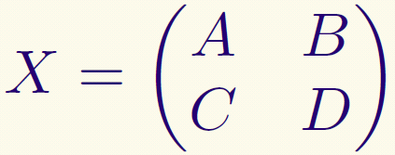
Construction of proofs
Construct circuits w/ division gates for inverse and determinant in block forms (gives poly-size circuits):
Notes:
Give the simple block construction

Slide 30
Construction of proofs
Prove statement about Det where:
1. Division gates allowed
2. Circuits have no depth
bound
Then apply structural results: get balanced, division-free proofs

Slide 31
Structure of argument
Arithmetic proofs with division gates
Arithmetic world
Define DET naturally there
Homogenization: Eliminate high degree terms from proofs
Prove properties of DET
Eliminate division gates from proofs
Propositional world
Balance the circuits in proofs: O(log²n)-depth
NC²-Frege: Transform balanced proofs into propositional proofs (immediate)

Slide 32
Crucial observation
Arithmetic Proofs are also propositional proofs (over GF(2))
Propositional
proofs
Arithmetic proofs (over GF(2))
Notes:
17’
The converse of Idea 1 is not true. Why? Search for example.
How does Reckhow deals with Extended Frege proofs?

Slide 33
Open problem
Uniform proofs of linear algebra
Use the arithmetic setting to derive new upper/lower bounds for propositional proofs?
More insights into propositional proofs

Slide 34
Thank you !

